Slide 1


Linh Mai
11 July 2022

Slide 2

Outline
Executive Summary
Introduction
Methodology
Results
Conclusion
Appendix

Slide 3
Executive Summary
Data is collected from online sources and wrangled to determine training labels. Visualization and SQL is applied to perform Exploratory Data Analysis (EDA). More insights are highlighted in interactive visual analytics using Folium and Plotly Dash. Classification models are employed in predictive analysis.
EDA analysis shows that factors including time, launch site, booster versions, payload mass, orbit type, landing type having impacts on a success launch. Interactive tools highlight the success ratio for each launch site and their geographical patterns. All predictive model perform equally in term of accuracy.

Slide 4
Introduction
Context:
SpaceX advertises Falcon 9 rocket launches with a much lower cost than competitors, thanks to its ability to reuse the first stage. If we can determine if the first stage will land, we can determine the cost of a launch and the probability that SpaceX will reuse the first stage.
Objectives:
predict if the Falcon 9 first stage will land successfully.

Slide 5

Section 1

Slide 6
Methodology
Executive Summary
Data collection methodology:
Requesting data from API and web-scrapping from Wikipedia.
Perform data wrangling
Cleaning and standardizing data before determining training labels.
Perform exploratory data analysis (EDA) using visualization and SQL
Perform interactive visual analytics using Folium and Plotly Dash
Perform predictive analysis using classification models
Four classification models have been built using training/testing sample and evaluated to determine the best performer.

Slide 7
Data Collection
Launch data is gathered from the SpaceX REST API and web scrapped from Wikipedia
Collected data includes: time, sites, booster, launch and landing specifications, mission and outcome.
SPACEX REST API request
Get HTML response from Wikipedia
JSON tables
Extract by BeautifulSoup
.csv file
.csv file
Data Frame

Slide 8
Data Collection – SpaceX API
Data is request from the SpaceX API and then normalized
Notebook
Request from SPACEX REST API
Convert response into JSON format
Feature Selection
Get core data
Construct Data Frame
Filter Falcon 9’s launches
Drop missing value
Export to .csv file

Slide 9
Data Collection - Scraping
Falcon 9 launch records in HTML tables are extracted from Wikipedia ‘Falcon9 Launches’ page, then convert to data frame.
Notebook
Getting Response from HTML
Extract HTML table column names
Parsing data from HTML tables into data frame
Create a BeautifulSoup object
Export to .csv file

Slide 10
Data Wrangling
Relevant data is transformed and analyzed.
Training labels are determined to be landing outcome class variable.
Notebook
Number of launches per site
Number and occurrence of mission outcome per orbit
Classify landing outcomes
Number and occurrence per orbit
Check null value
Handle null value

Slide 11
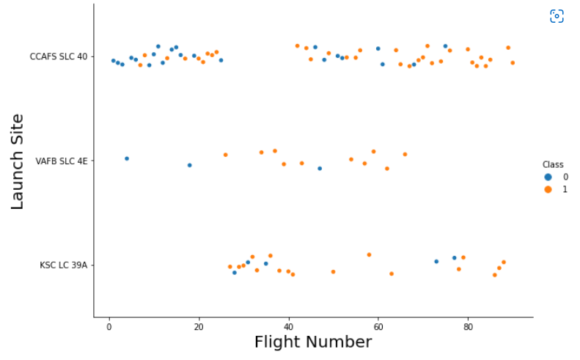
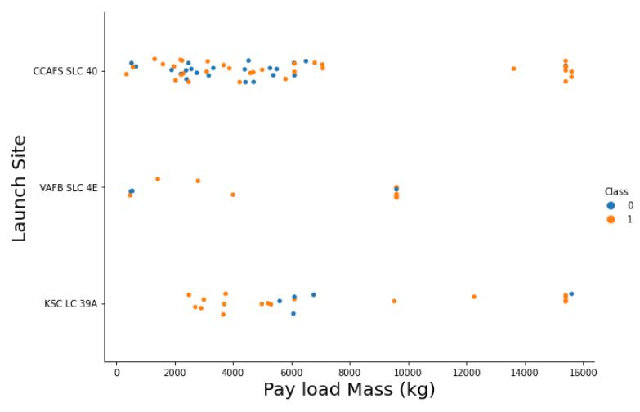
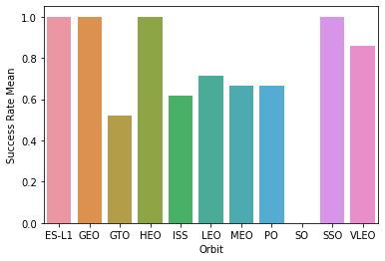
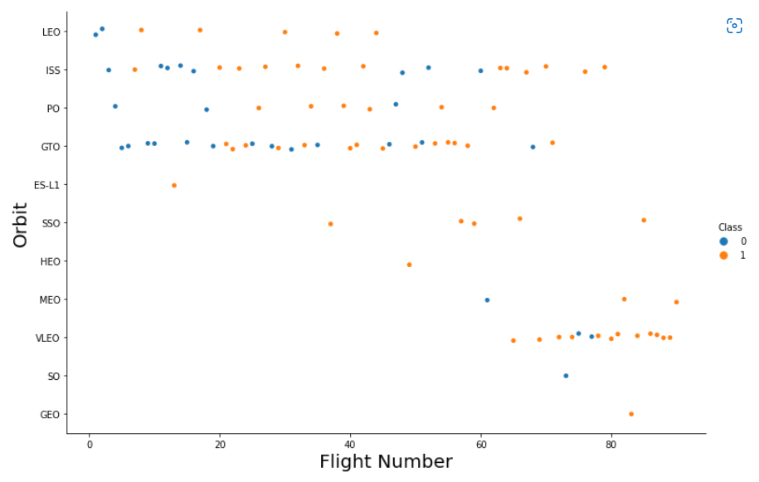
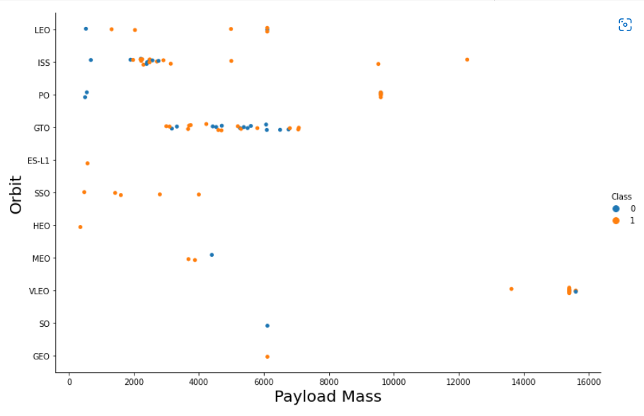
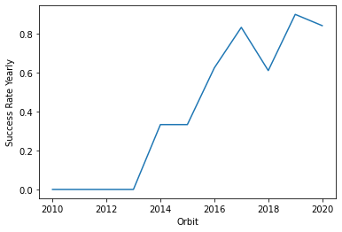
EDA with Data Visualization
Notebook

Slide 12
EDA with SQL
Notebook
SQL queries are to get insights from the dataset, including:
Launch sites lists
Records where launch sites begin with 'CCA’
Total payload mass carried by NASA’s boosters
Average payload mass carried by booster version F9 v1.1
Date of the first successful landing outcome in ground pad
Boosters which have success in drone ship, 4000 < payload mass < 6000
Total number of successful and failure mission outcomes
Booster versions which have carried the maximum payload mass.
Failure landings in drone ship in year 2015.
Successful landing outcomes from 04-06-2010 to 20-03-2017.

Slide 13
Build an Interactive Map with Folium
All launch sites are marked on a map, with circles and labels popup sites’ names.
Green/red markers are added indicating the success/failed launches for each site.
Distances and polylines between a launch site to its proximities are included.
These tools are aim to find some geographical patterns about launch sites and their impacts on launch success rate, such as their location, proximity to Equator line and the coastline, success rates for each site, the proximity to transport facilities and urban areas.
Notebook

Slide 14
Build a Dashboard with Plotly Dash
Pie charts of total success launches for all sites and for each site, with a dropdown list to choose displaying options.
Scatter point charts showing the correlation between payload and success for all sites with a range slider of payload mass from 0 to 10000 kg.
These plots and interactions might help to get insights from the dataset more easily than with static graphs.
Plotly Dash lab

Slide 15
Predictive Analysis (Classification)
We consider four methods: Logistic Regression, Support Vector Machine, K Nearest Neighbor, Tree Classifications.
Predictive models are analyzed through confusion matrix and evaluated by accuracy score.
Notebook
Test/train split
Hyperparameter grid search
Build predictive models and evaluate
Train different classification models

Slide 16
Results
Factors having impacts on success launching include time, launch site, booster versions, payload mass, orbit type, landing type.
The optimal launch site is in proximity to Equator line, coastline, transport facilities, and within a certain distance from urban areas.

Slide 17
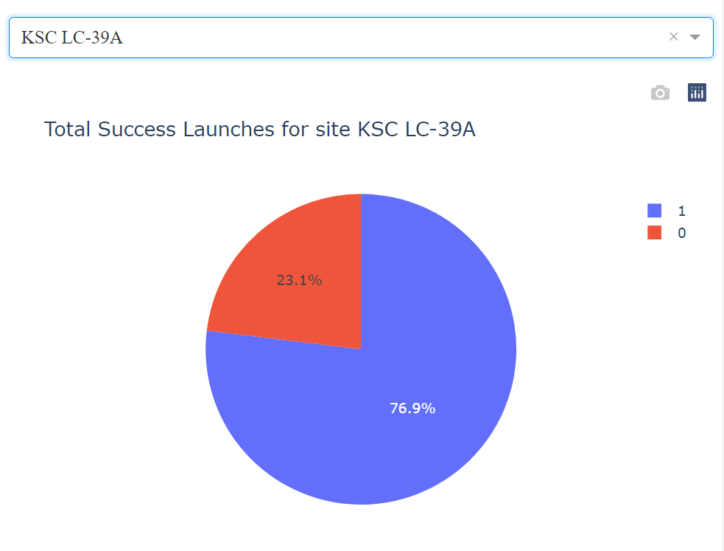
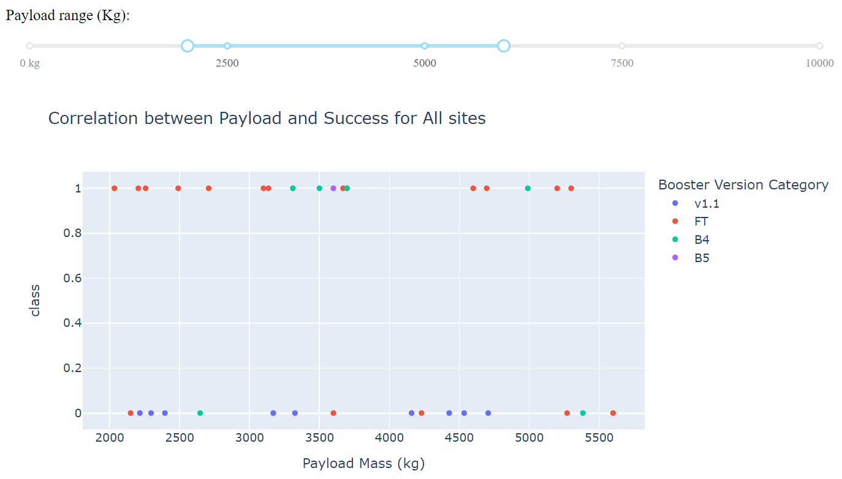
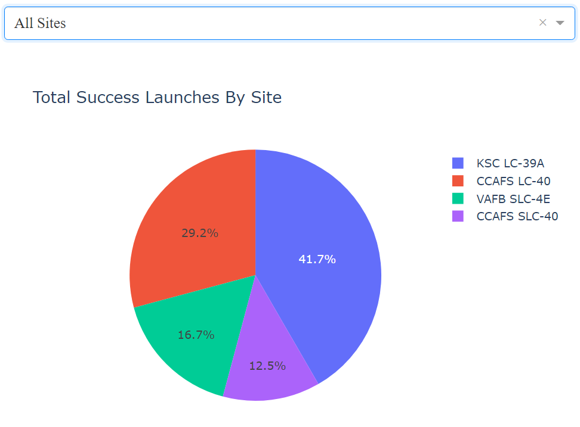
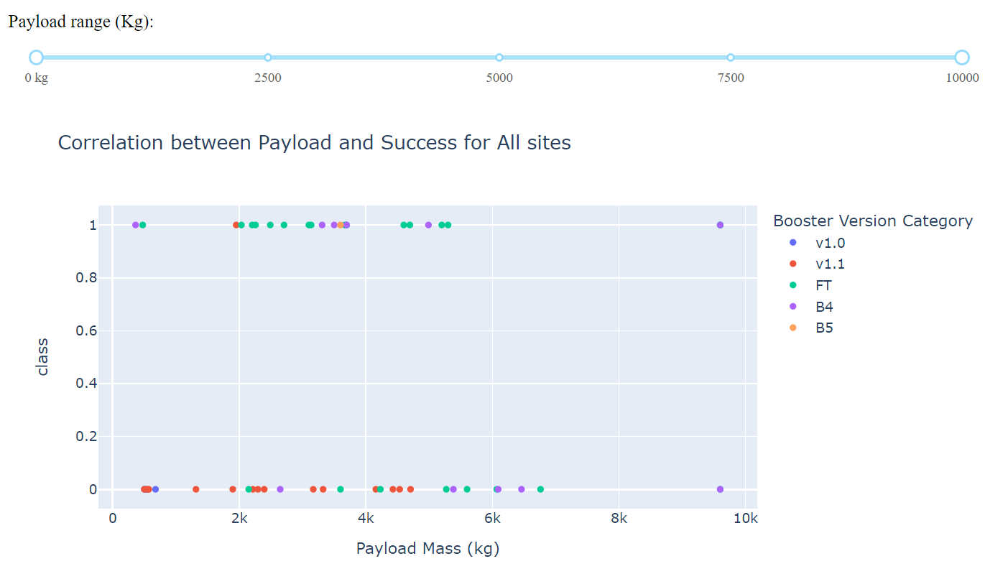
Results

Slide 18
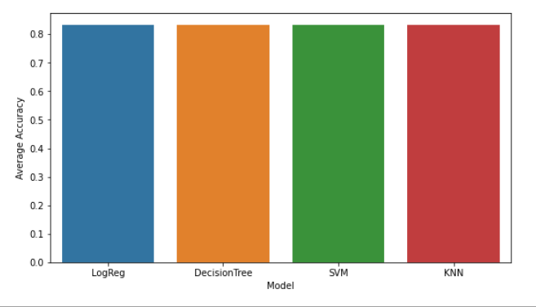
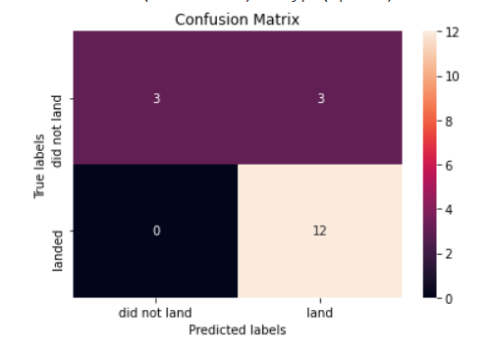
Results
Logistic Regression, Tree Classifications, Support Vector Machine and K Nearest Neighbor all achieve the same prediction accuracy for this dataset.

Slide 19

Section 2

Slide 20
Flight Number vs. Launch Site
Most launches in the earlier period were conducted in CCAFS LC-40.
CCAFS LC-40 has a success rate of 60 %, while KSC LC-39A and VAFB SLC 4E has a success rate of 77%

Slide 21
Payload vs. Launch Site
In VAFB-SLC launch site there are no rockets launched for heavy payload mass (greater than 10000).

Slide 22
Success Rate vs. Orbit Type
There is no successful landing with the SO orbit.
ES-L1, GEO and SSO have 100% successful landings.
Except SO, all orbit types have successful rate over 50%.

Slide 23
Flight Number vs. Orbit Type
In the LEO orbit the Success appears related to the number of flights
There seems to be no relationship between flight number when in GTO orbit

Slide 24
Payload vs. Orbit Type
With heavy payloads, the successful landing or positive landing rate are higher for Polar, LEO and ISS.
For GTO, the trend is unclear as both positive landing rate and negative landing (unsuccessful mission) are scattered.

Slide 25
Launch Success Yearly Trend
There was no success launch until 2013;
It started increasing from 2013 and kept the upward trend till 2020.

Slide 26
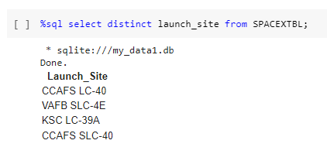
All Launch Site Names
Launch site "CCAFS SLC-40" is previously known as "CCAFS LC-40“, therefore there are four site names listed while in fact only three launch sites exist.

Slide 27
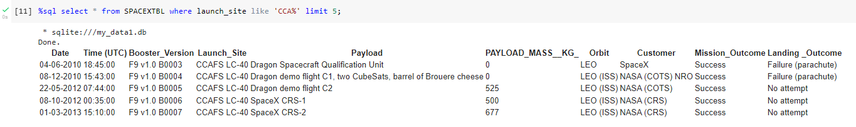
Launch Site Names Begin with 'CCA'
Launch site ‘CCAFS SLC-40’ is previously known as ‘CCAFS LC-40’.

Slide 28
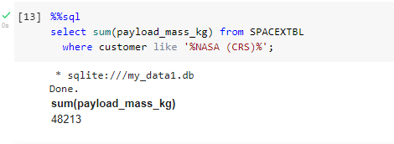
Total Payload Mass
The total payload mass carried by boosters ordered by NASA Commercial Resupply Services is 48,213 kilogram.

Slide 29
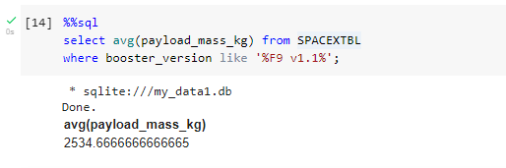
Average Payload Mass by F9 v1.1
The average payload mass carried by booster version F9 v1.1 is approximately 2,534.67 kilogram. This counts all booster versions of F9 v1.1 model (for example, F9 v1.1 B1003, F9 v1.1 B1011 etc).

Slide 30
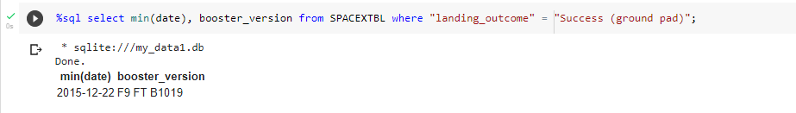
First Successful Ground Landing Date
The first successful landing outcome on ground pad was carried out by Falcon 9 FT model version B1019 in 22 December 2015, five and a half year from the first mission by Falcon 9 v1.0 model in 04 June 2010.

Slide 31
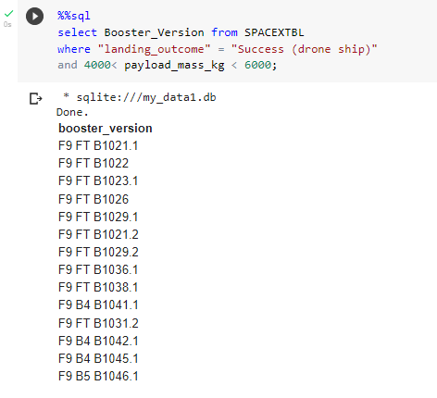
Successful Drone Ship Landing with Payload between 4000 and 6000
There are 14 boosters which have successfully landed on drone ship and had payload mass between 4000 and 6000.

Slide 32
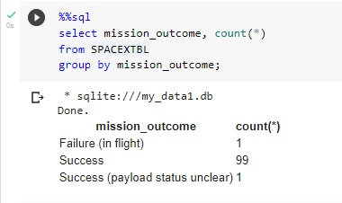
Total Number of Successful and Failure Mission Outcomes
The rate of successful outcomes is 99 percent. Among 101 mission, there is only one failure outcome and one with payload status unclear. The difference between mission outcomes and landing outcome implies that most mission outcomes were planned.

Slide 33
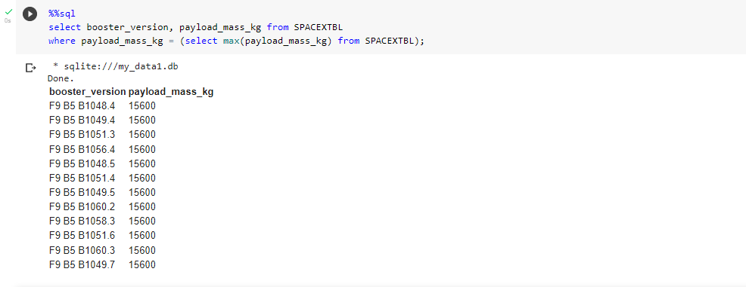
Boosters Carried Maximum Payload
The maximum payload mass is 15,600 kg, carrying by F9 B5 B10 version, carrying 15,600 kg.

Slide 34
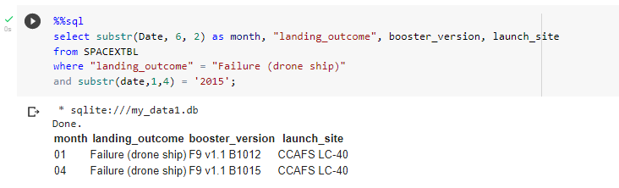
2015 Launch Records
Both missions attempted to land in drone ship in 2015 were failed. Both were carried out by F9 v1.1 versions and took off from launch site CCAFS LC-40.

Slide 35
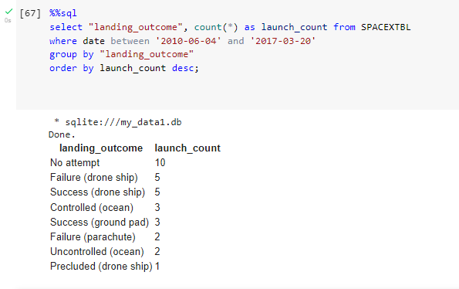
Rank Landing Outcomes Between 2010-06-04 and 2017-03-20
Between 2010-06-04 and 2017-03-20, there were 31 missions conducted in total. A half of landing attempts (52.38%) were on drone ship with the success rate of 45.45%.

Slide 36

Section 3

Slide 37
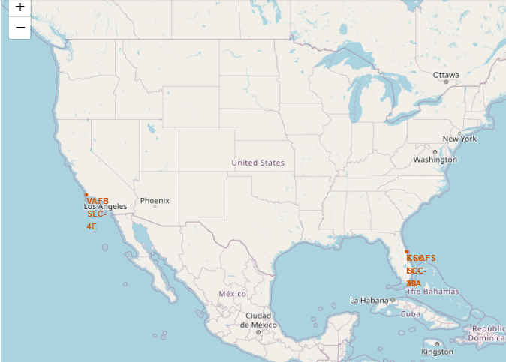
Launch Sites marked on map
All three launch sites are in proximity to the Equator line and the coast.
Both sites CCAFS SLC-40 and KSC LC-39A are in the same area in the east Florida coast, while site VAFB SLC-4E site is located to the South California coast.

Slide 38
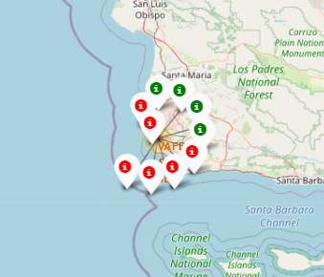
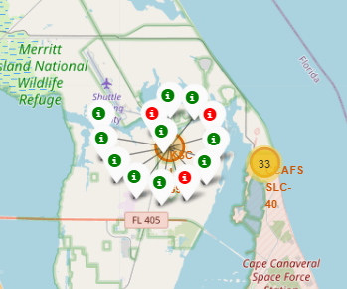
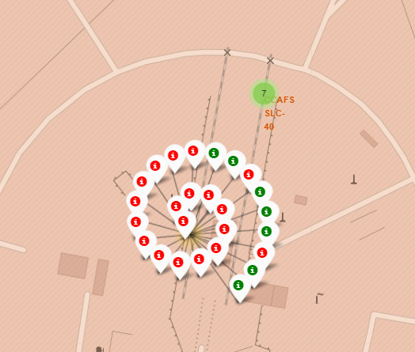
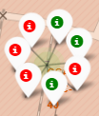
Sites marked for success/failed launches
Site KSC LC-39A appears to have relatively high success rates (76.92 %), in comparison to CCAFS SLC-40 (previously CCAFS LC-40) and VAFB SLC-4E (30.30 % and 40.00 %, respectively).

Slide 39
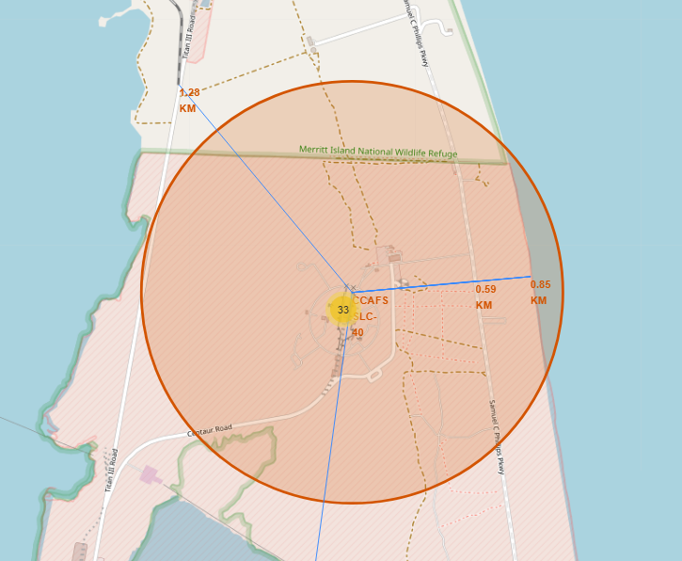
Distances from CCAFS SLC-40 to its proximities
Launch site CCAFS SLC-40 is well connected to transport facilities, including highway (0.59 km), railway (1.28 km), coastline (0.85 km).
The nearest large city with an international airport is Melbourne, which is outside of neighborhood but still within a convenient distance (52.07 km).
An optimal launch site should be in proximity to the Equator line and the coastline, as well as well-connected to transport facilities.

Slide 40

Section 4

Slide 41
Total success launch by site
KSC LC-39A accounts for 41.7 % of total success launches, equal proportion with site CCAFS LC-40/ CCAFS SLC-40.

Slide 42
Total Success Launches for site KSC LC-39A
KSC LC-39A has highest success launch rate among all sites, averagely 3 in 4 launches are success.

Slide 43
Correlation between Payload and Success for All sites
Small-lift boosters (payload <2000 kg) are more likely to fail than medium-lift boosters.
Most success launches have payload mass in range of 2000-6000 kg.

Slide 44

Section 5

Slide 45
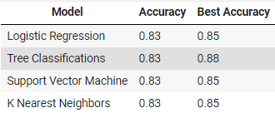
Classification Accuracy
All models achieve the similar accuracy (83%), which can be partly explained by their non-complexity and small dataset.
In term of best accuracy, Tree Classifications has the highest score (87%)

Slide 46
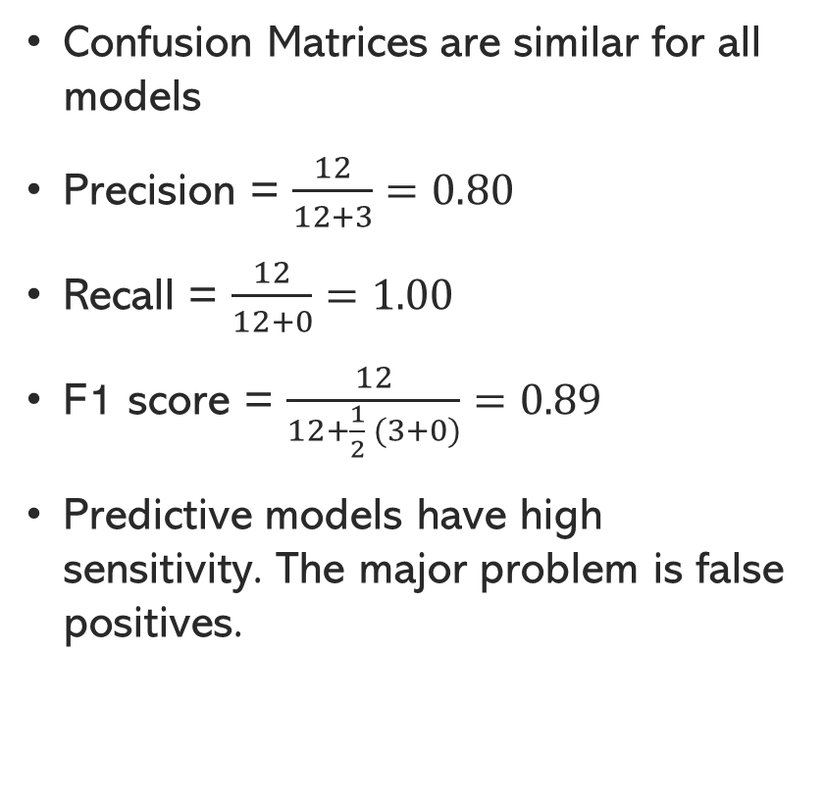
Confusion Matrix
Confusion Matrices are similar for all models
Precision = $\frac{12}{12+3}=0.80$
Recall = $\frac{12}{12+0}=1.00$
F1 score = $\frac{12}{12+\frac{1}{2} (3+0)}=0.89$
Predictive models have high sensitivity. The major problem is false positives.

Slide 47
Conclusions
Decision Tree, SVM, KNN, and Logistic Regression models achieve the similar prediction accuracy. Decision Tree performs better in term of best score.
Medium-lift boosters perform better than small-lift boosters.
The success rates increase over time as SpaceX gradually improves their technologies.
KSC LC 39A had the highest success launches ratio among all the sites.
Orbit GEO, HEO, SSO, ES L1 has 100 percent success rate.

Slide 48


